Slide 1

Predicting Customer Buying Behaviour
Athulya M Aspiring Data Analyst

Slide 2
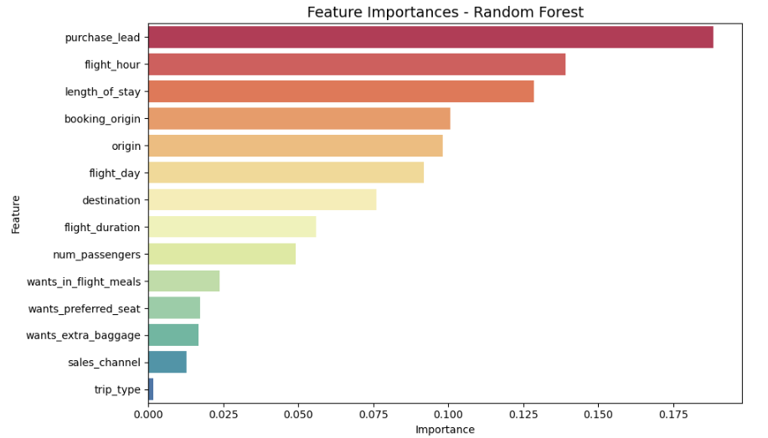
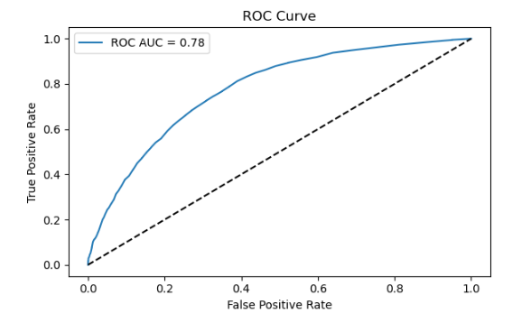
Predictive Model To Understand Factors That Influence Buying Behaviour
Model: Random Forest Classifier
Trained on 80% of the data.
Evaluated on 20% test data.
Feature Importance (Top Contributors)
purchase_lead
flight_hour
length_of_stay
num_passengers
wants_extra_baggage
Overall Accuracy – 85%
ROC AUC Score – 0.78
Model has decent discriminatory power.

